Slide 1
Real-Time E-commerce Data Processing and Analysis
Nagwa Saad Abo shabaan
Salma Hisham Mohamed
Norhan Mohamed Swar

Slide 2
Tools and Technologies
01
02
03
04
05
Hadoop
YARN
Apache Kafka
Apache Spark
Postgresdb
To store and preprocess the large datasets of user logs and transaction data.
To efficiently manage resources for complex analytics tasks
To ingest real-time e-commerce transaction data.
For real-time data processing and to analyze customer behavior and predict future buying patterns.
For store the the result of Data analysis and insights

Slide 3
Exploratory Data Analysis (EDA)

Slide 4
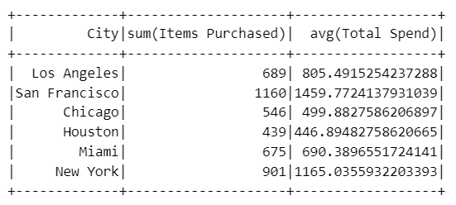
Q1: Can we segment customers based on their demographic information and shopping behaviors
- Customer Segmentation based on 'City', and 'Item Purchased'

Slide 5
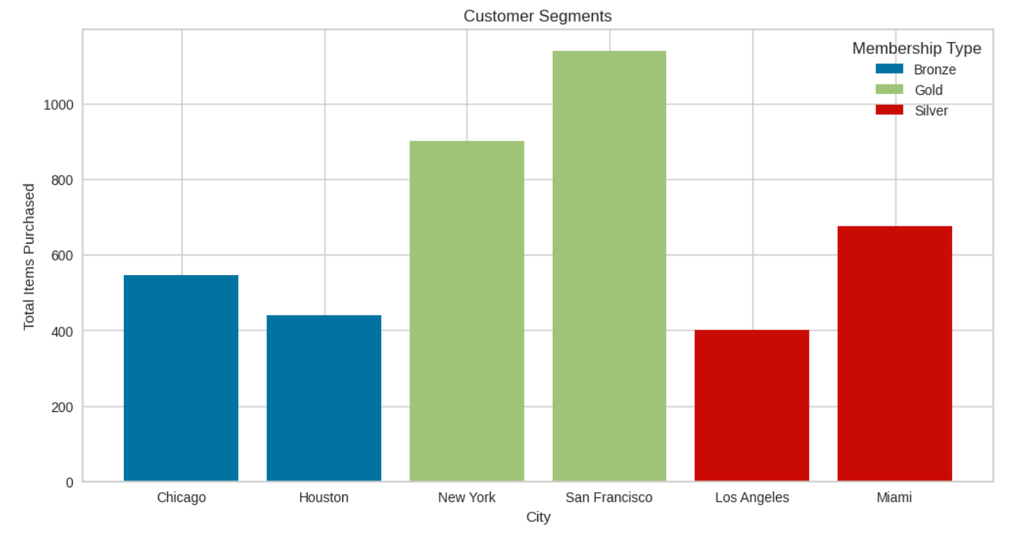
Q1: Can we segment customers based on their demographic information and shopping behaviors
- Customer Segmentation based on 'Membership', 'City', and 'Item Purchased

Slide 6
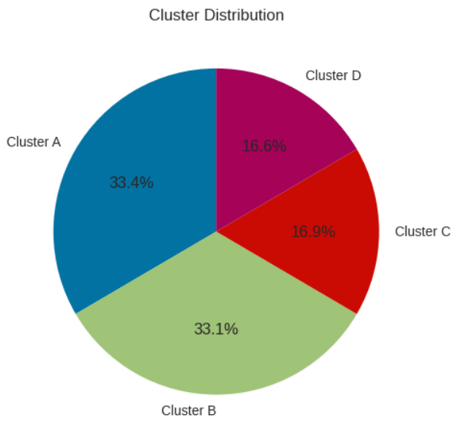
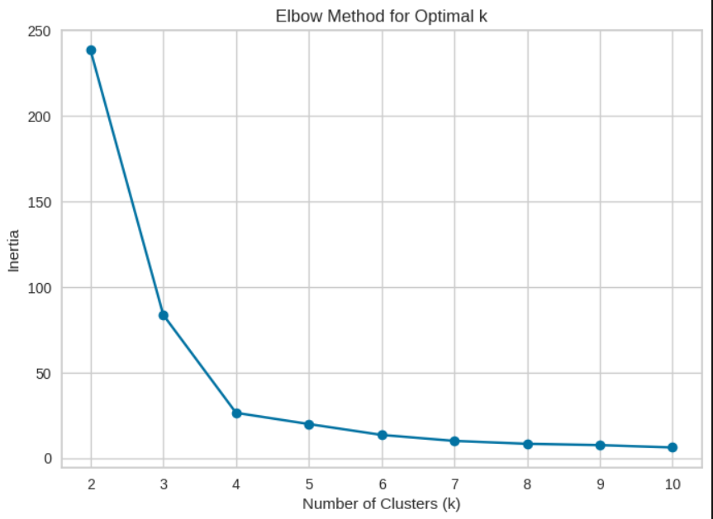
Q1: Can we segment customers based on their demographic information and shopping behaviors
- Customer Segmentation based on their 'Membership Type', 'Total Spend', and 'Items Purchased' Using K-means.

Slide 7
Q2 : Which customers are at risk of not making future purchases based on their Days Since Last Purchase and Satisfaction Level
• The result provides a list of customers who have not made a purchase within the duration ranges from 32 to 55 days and have expressed dissatisfaction.
• The identified at-risk customers are primarily from the Bronze and Silver membership types.
• Indicates that customers with lower-tier memberships might be more prone to dissatisfaction.

Slide 8
Pre-processing steps:
Drop Nulls and Customer IDs
Encode Categorical Columns
Pipeline
Standardization
Vector Assembler
Then we saved the pipeline in the ‘Preprocessing Pipeline’ folder to use in streaming.

Slide 9
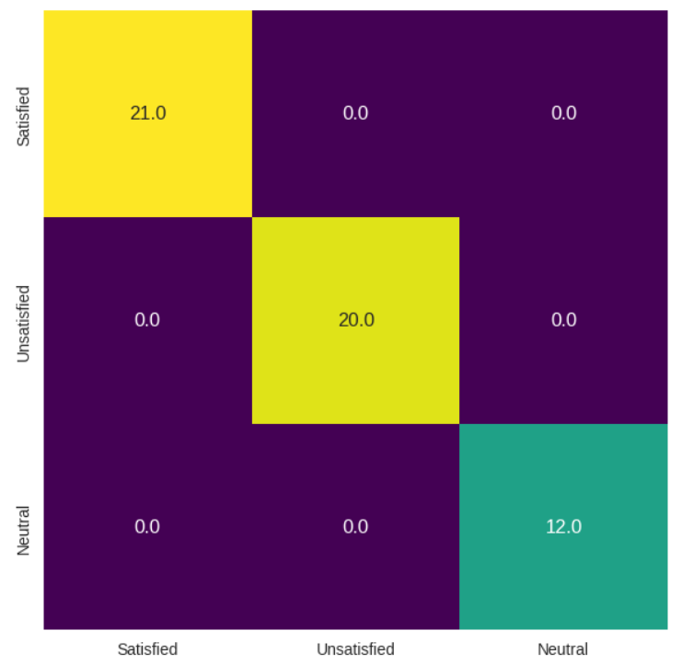
Model Pipeline Initialization: - Create the logistic regression classifier. - Build the pipeline model that uses all feature engineering steps and the model. - Train the pipeline model using the training dataset.
Logistic Regression for customer’s Satisfaction Level prediction based on their demographic and purchase history data
Data seems to be a little bit perfect :D

Slide 10
Simulate Real-time e-commerce transaction data using a real-time data generator

Slide 11
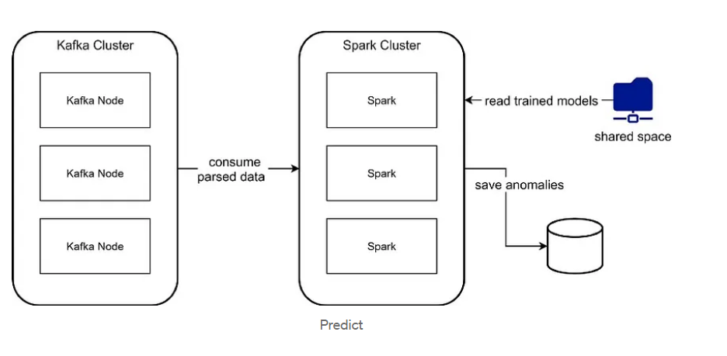
Producer and Consumer workflow:

Slide 12
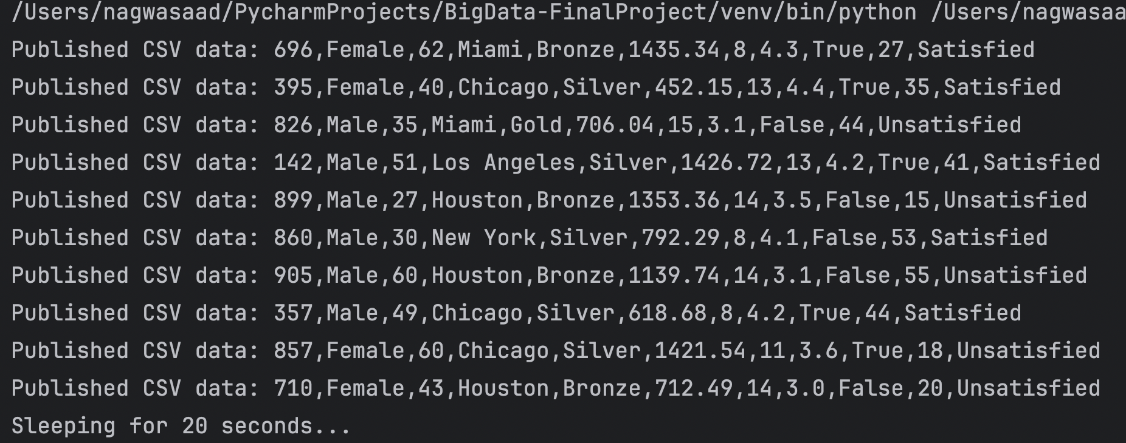
Producer workflow
Producer to simulate real time E-commerce Data generator.
KafkaMessage={customer_id},{gender},{age},{city},{membership_type},{total_spend},
{items_purchased},{average_rating},{discount_applied},{days_since_last_purchase},{satisfaction_level}"

Slide 13
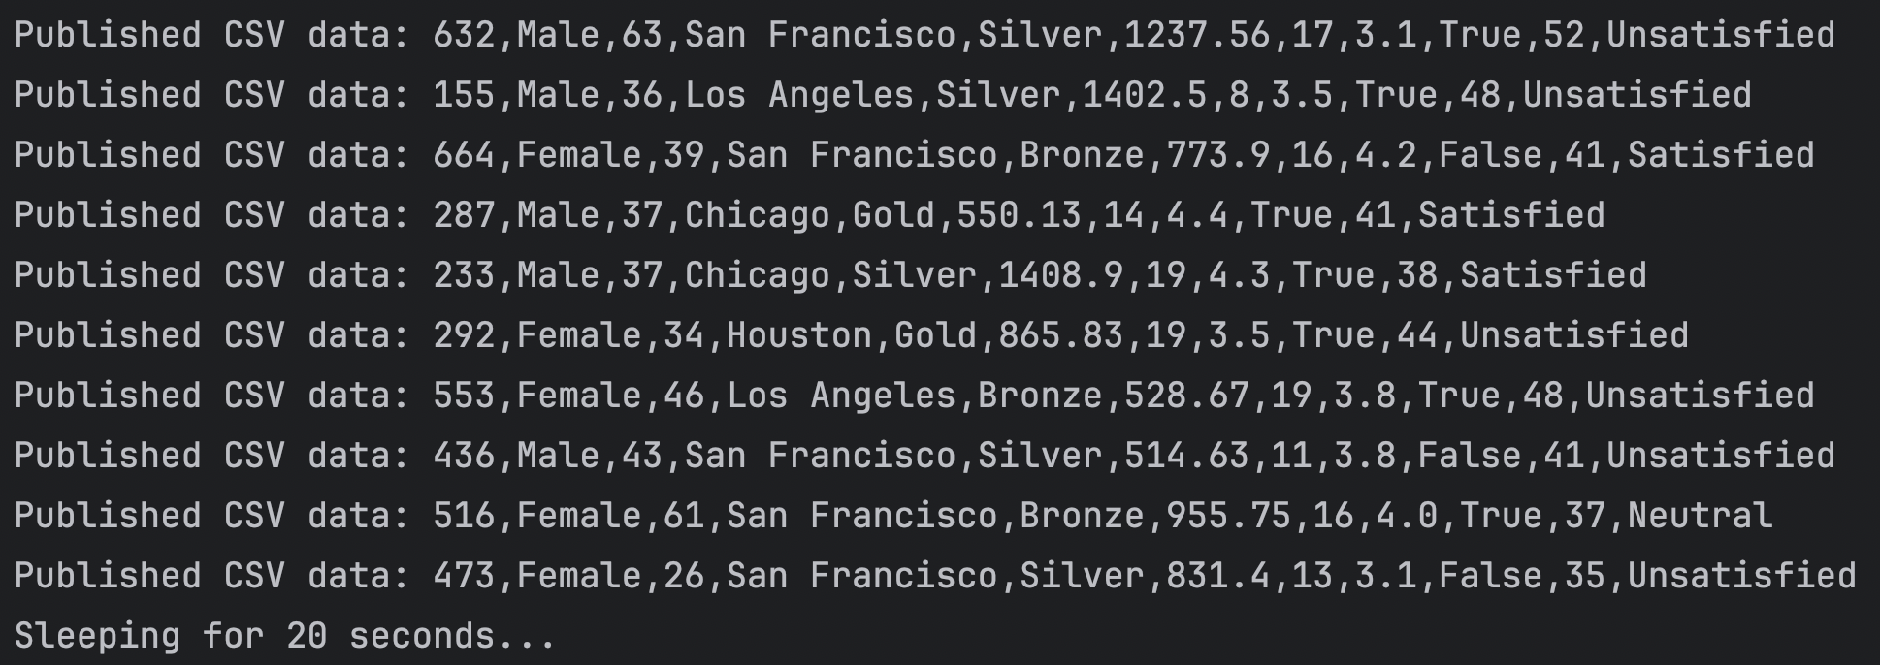
Producer workflow
Producer to simulate real time E-commerce Data generator.

Slide 14
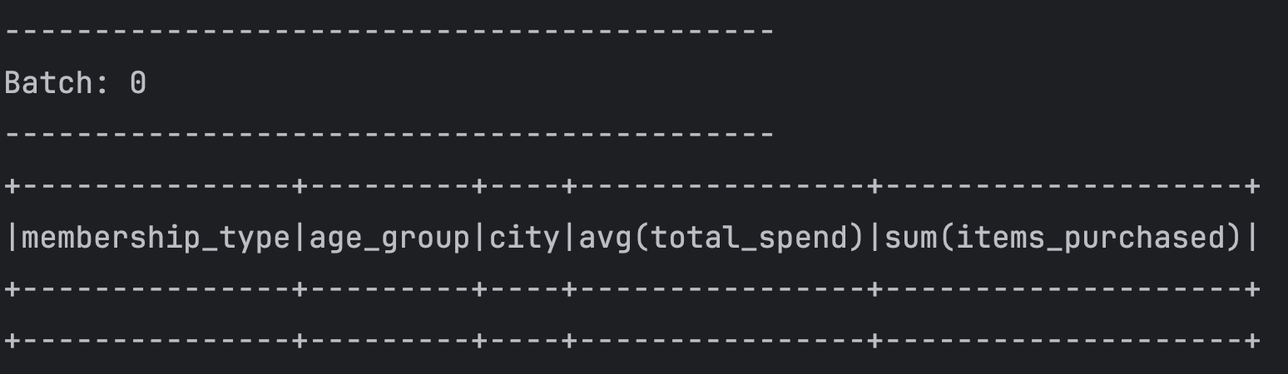
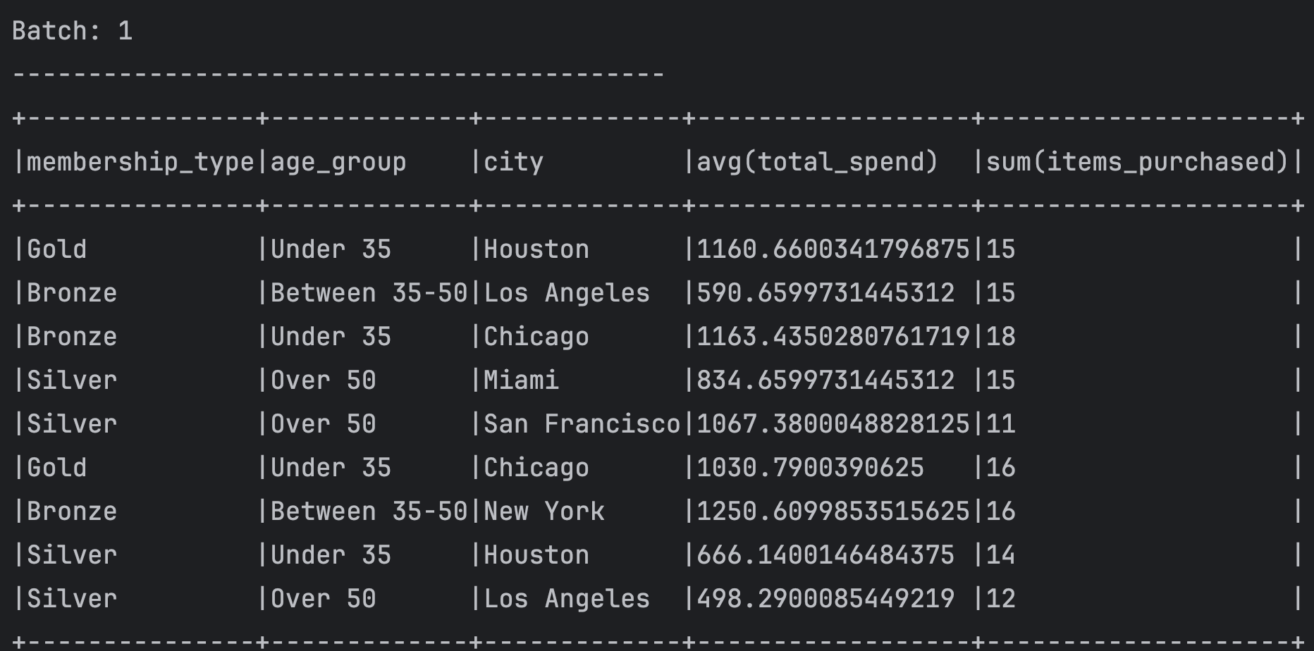
Consumer workflow (First Insight)
Consumer using Kafka topic + Spark Structure Streaming and generate business insights in real time
Avg(Total Spent) and Sum(items_purchased) Group by Membership Type, Age Group, and City

Slide 15
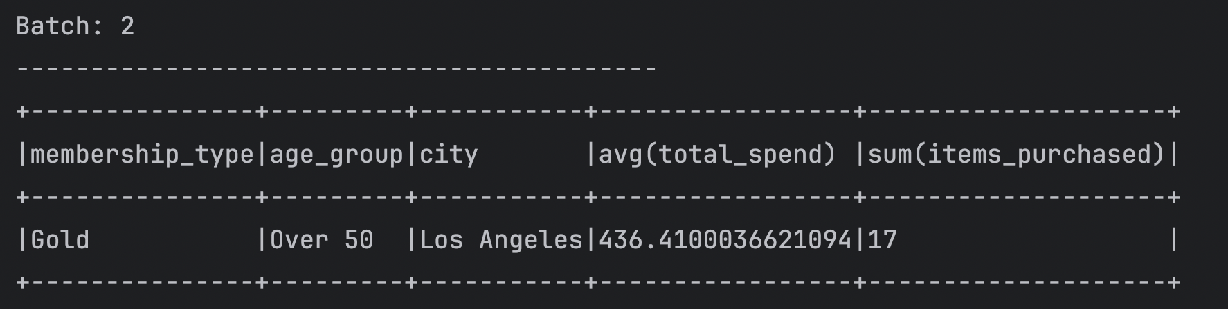
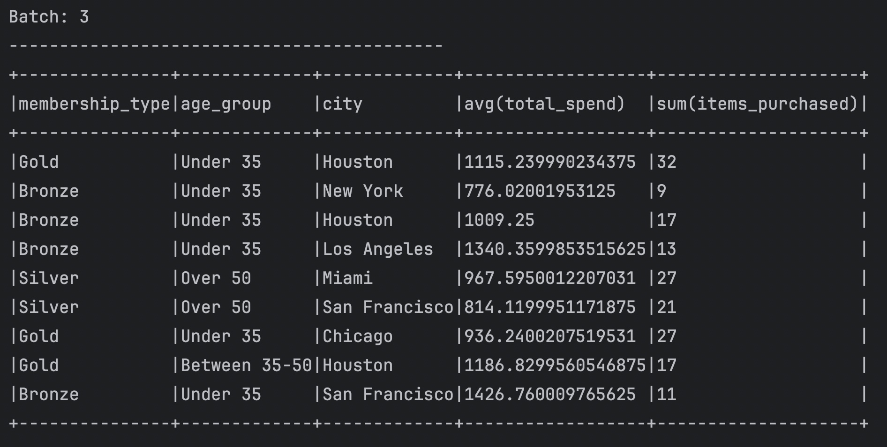
Consumer workflow (First Insight)
Consumer using Kafka topic + Spark Structure Streaming and generate business insights in real time
Avg(Total Spent) and Sum(items_purchased) Group by Membership Type, Age Group, and City

Slide 16
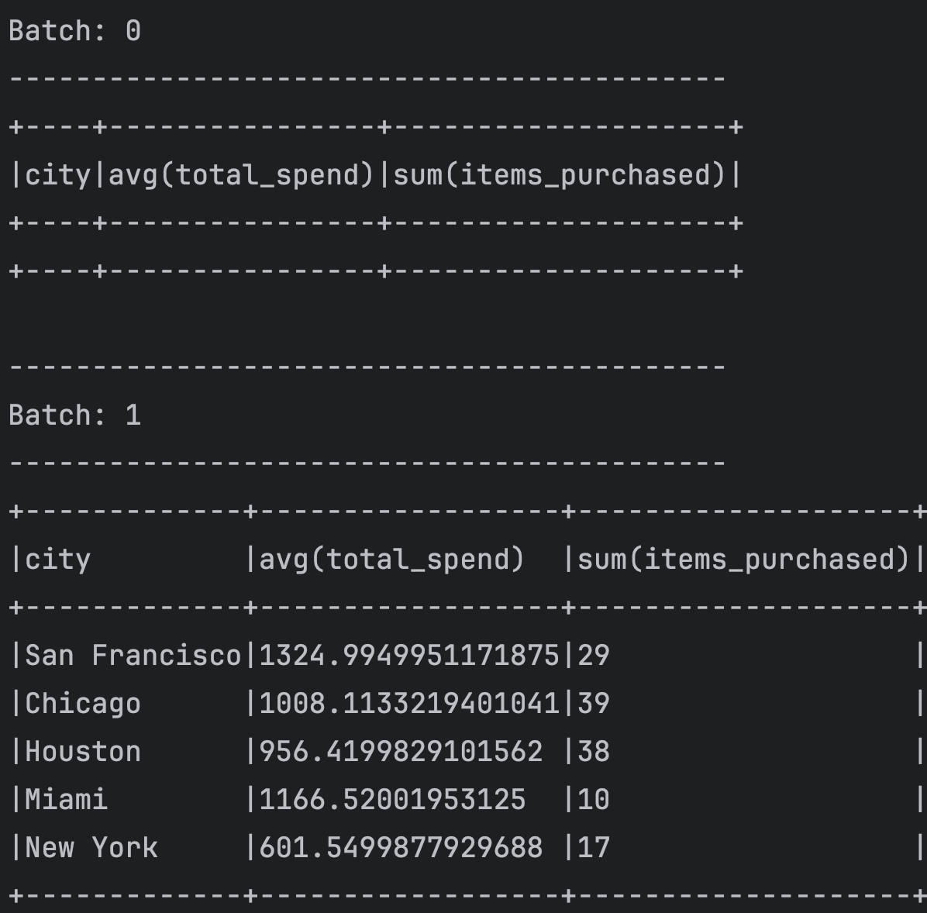
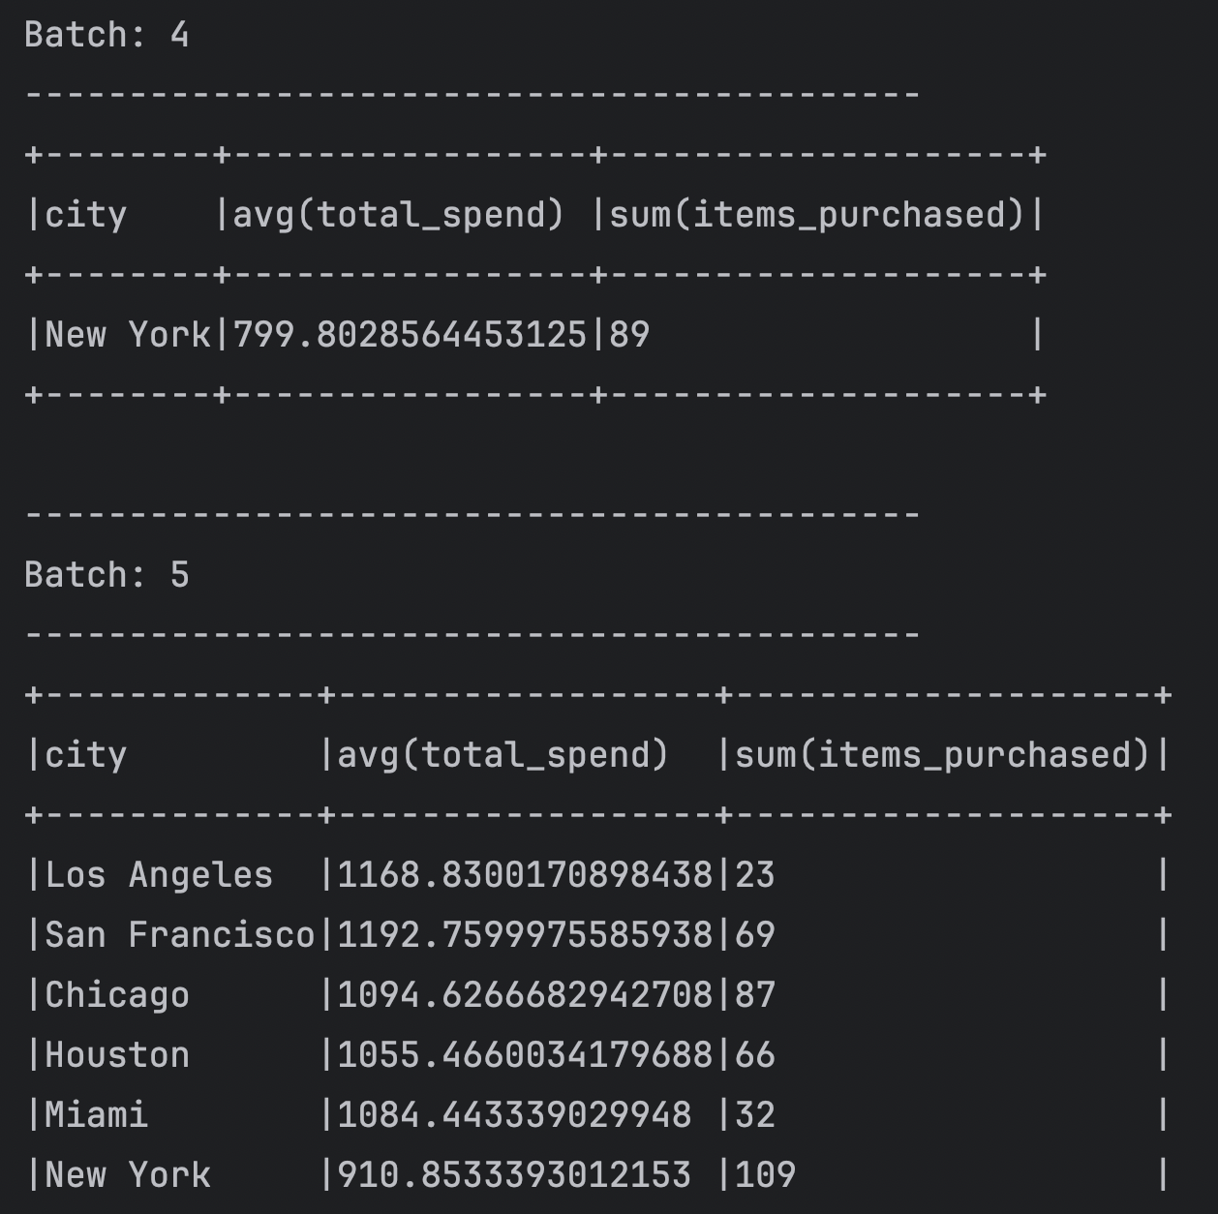
Consumer workflow (Second Insight)
Consumer using Kafka topic + Spark Structure Streaming and generate business insights in real time
Avg(Total Spent) and Sum(items_purchased) Group by City

Slide 17
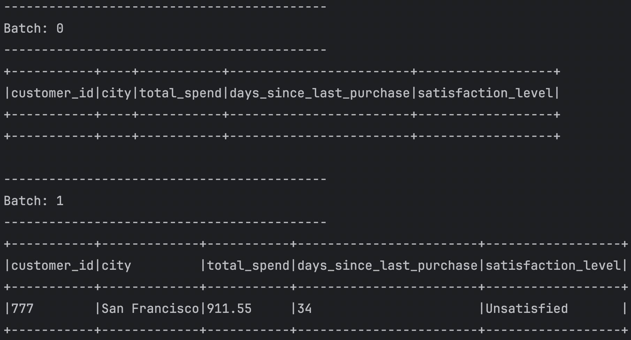
Consumer workflow (Third Insight)
Consumer using Kafka topic + Spark Structure Streaming and generate business insights in real time
Which customers are at risk of not making future purchases based on their Days Since Last Purchase and Satisfaction Level

Slide 18
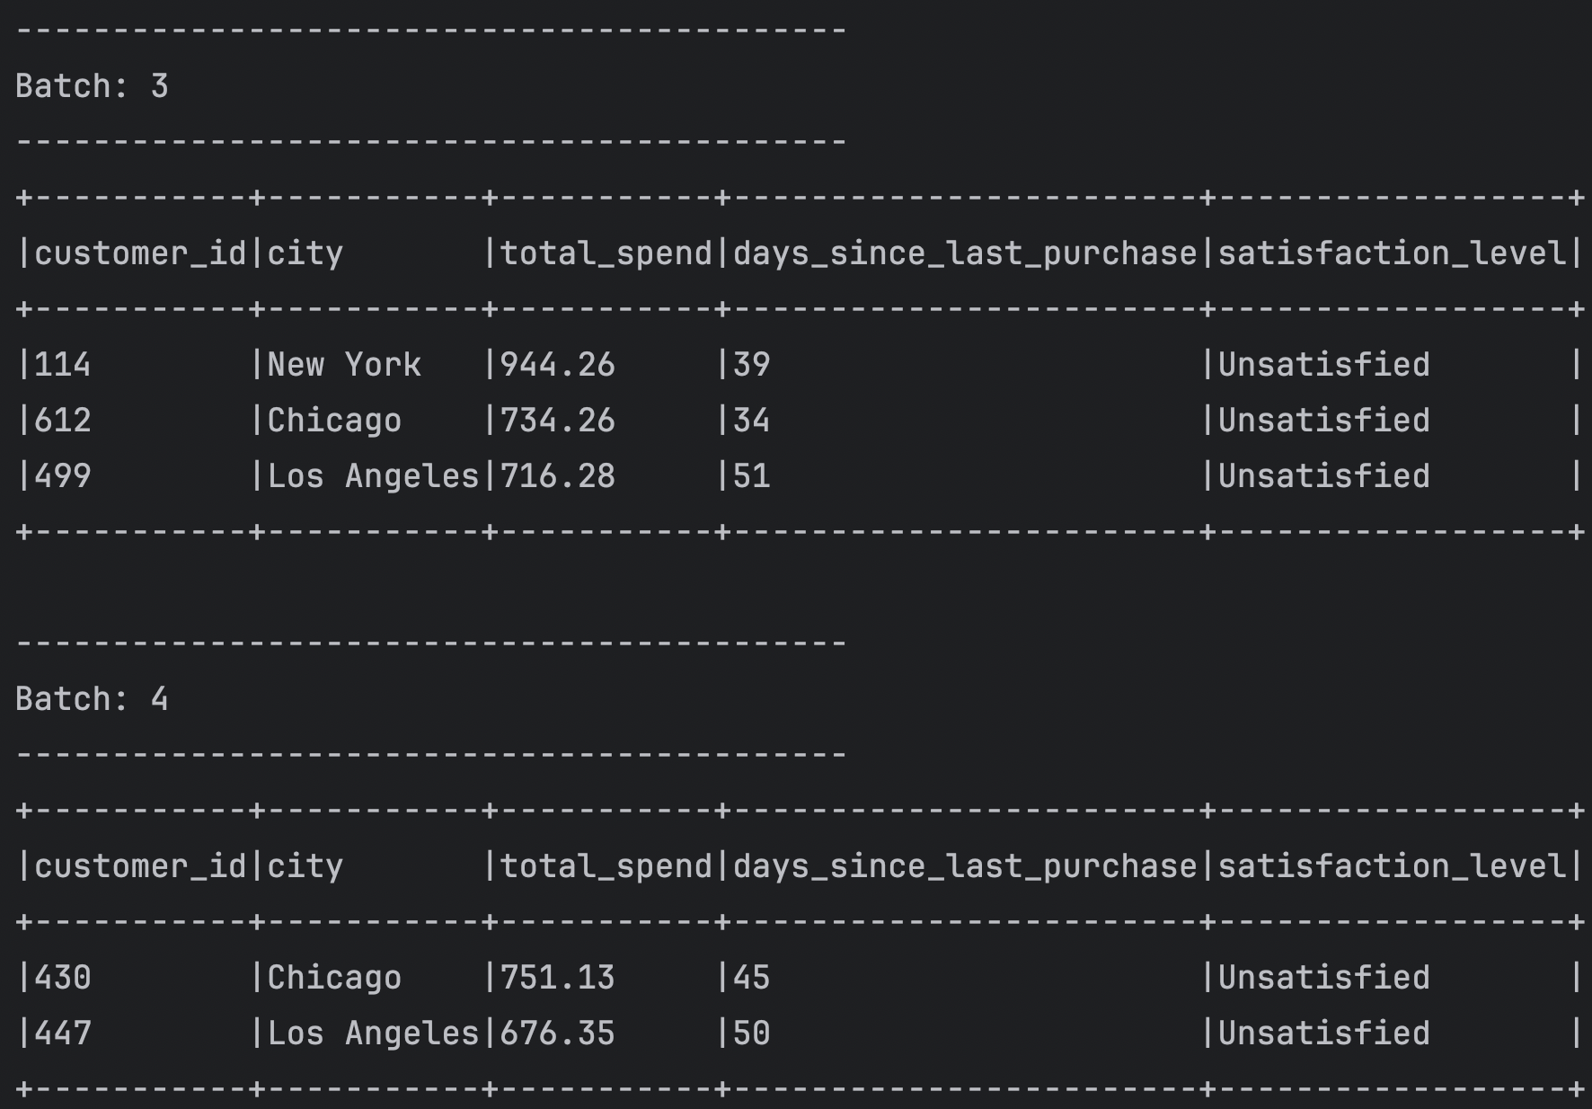
Consumer workflow (Third Insight)
Consumer using Kafka topic + Spark Structure Streaming and generate business insights in real time
Which customers are at risk ,not making future purchases based on their Days Since Last Purchase and Satisfaction Level

Slide 19
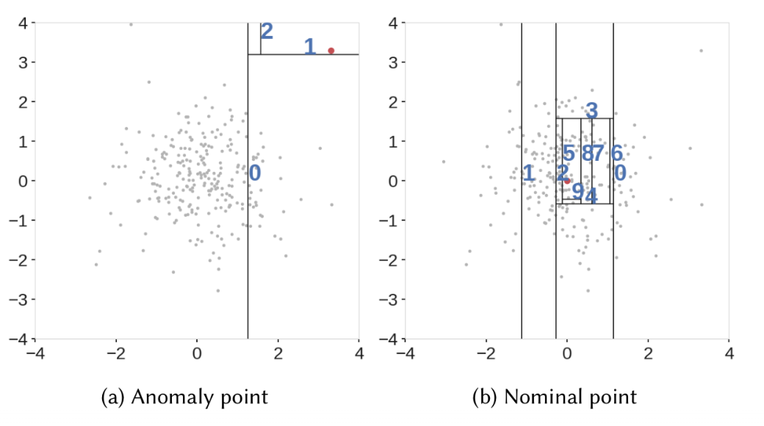
Anomaly Detection Pipeline: - Train the Isolation Forest on the historical data. - Create the topics. - Generate test data by Producer - Outliers Detector by Consumer
Why?
- It's an ensemble method based on decision trees and is efficient for detecting outliers.
- Can be adapted for streaming data by updating the existing forest as new data points arrive.
Train Isolation Forest for detecting anomalies in real-time

Slide 20
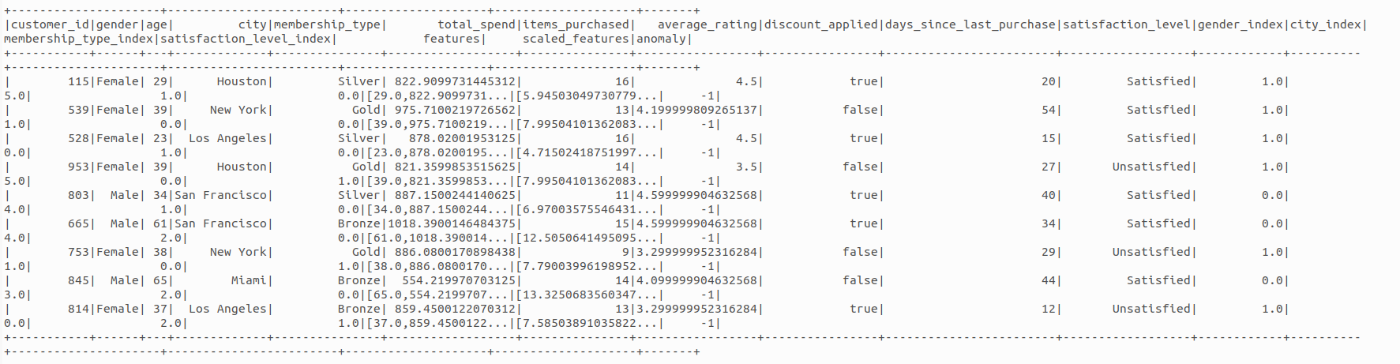
Predict the anomalies in real-time:

Slide 21
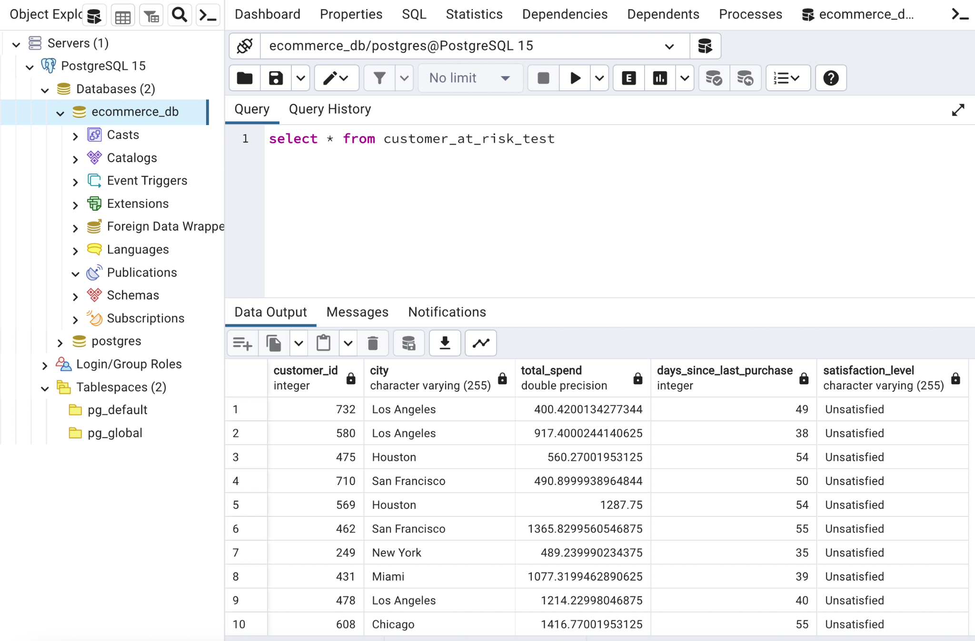
Storage layer for Data Analytics Results
Which customers are at risk ,not making future purchases based on their Days Since Last Purchase and Satisfaction Level

Slide 22
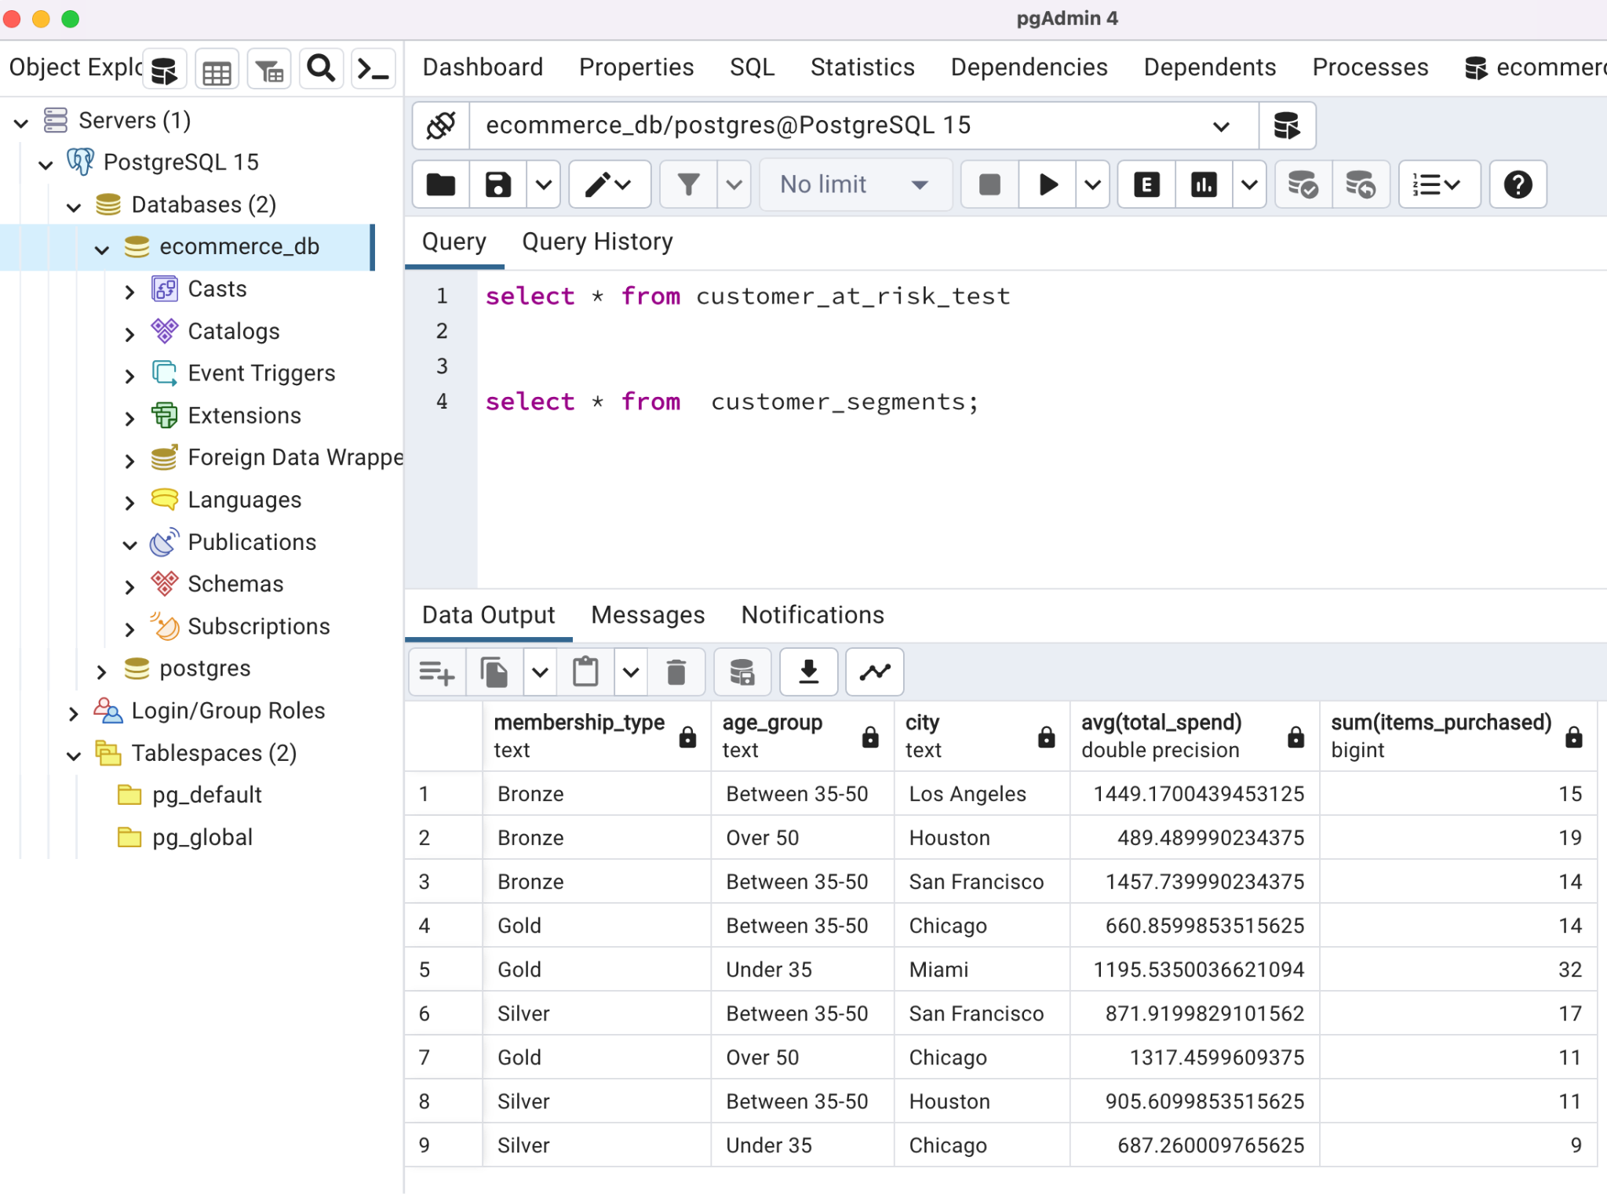
Storage layer for Data Analytics Results
Customer behaviour Analysis and segmentation based on age Group

Slide 23
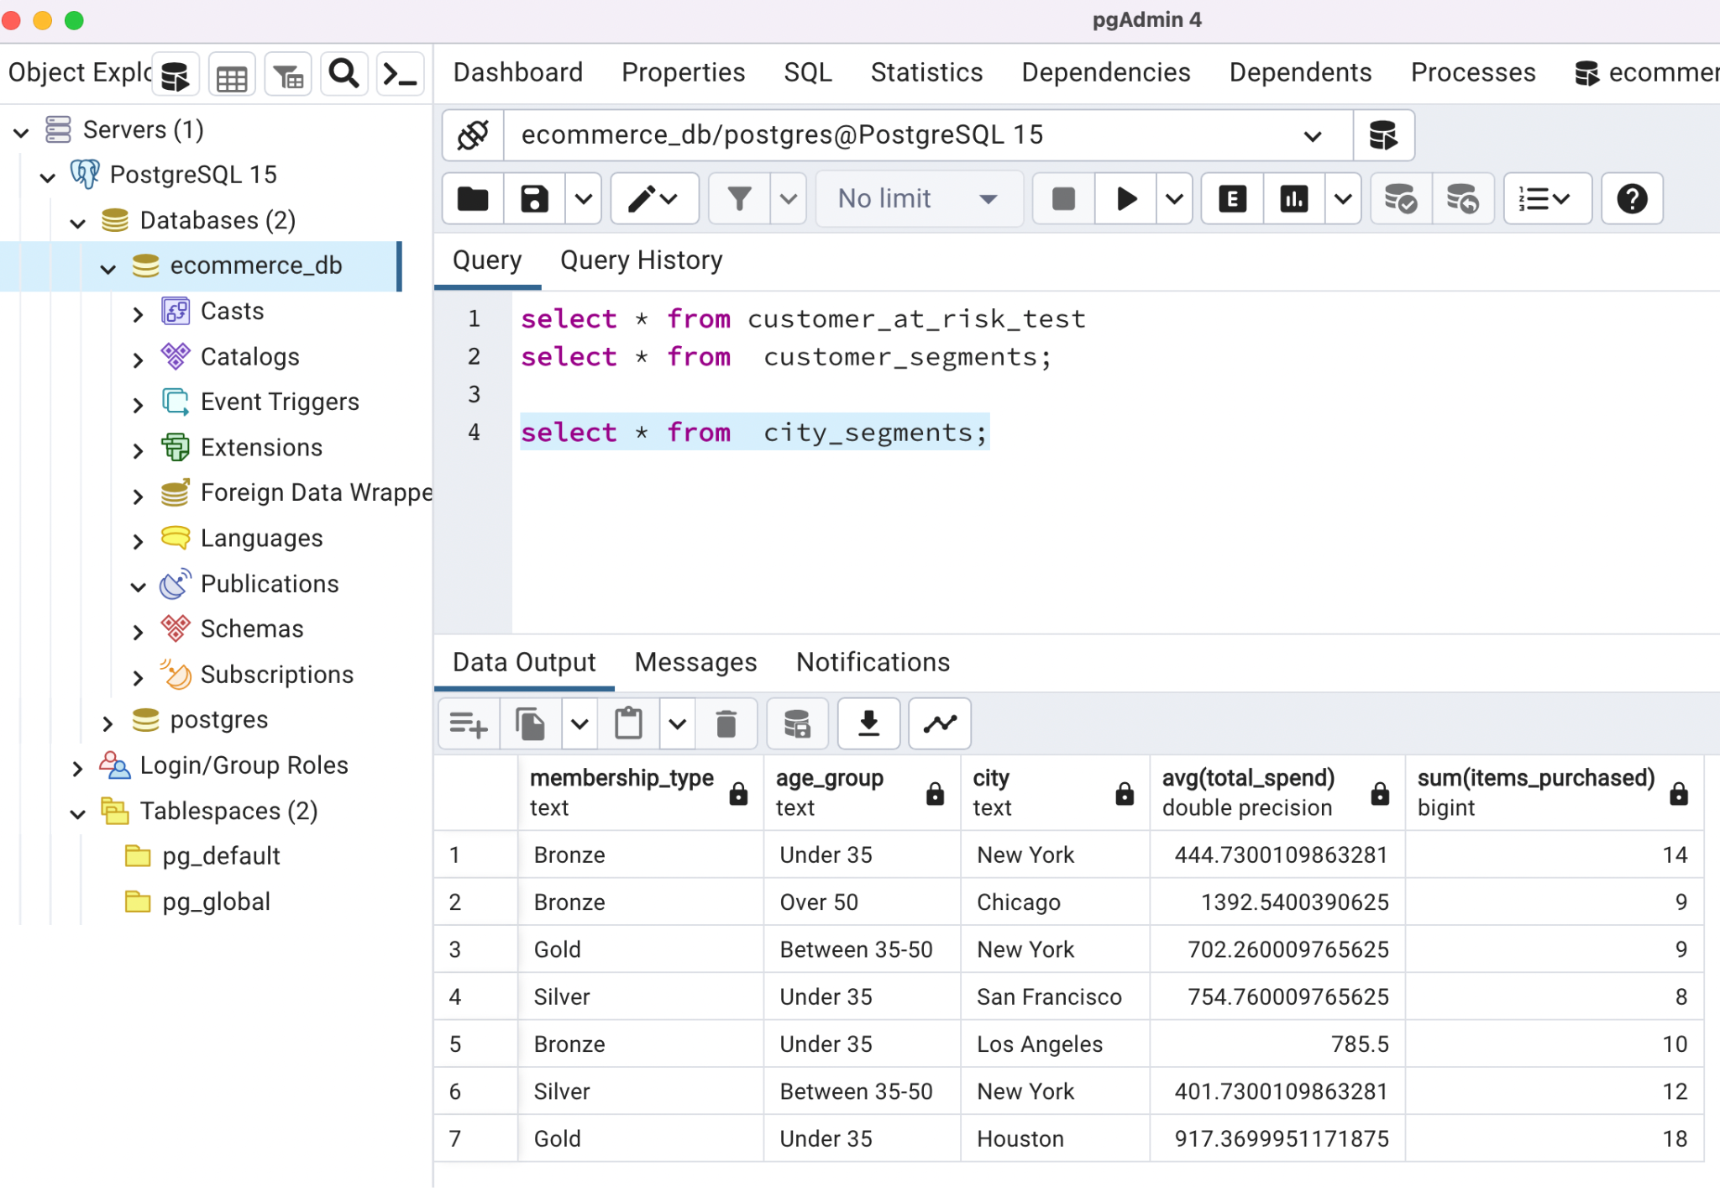
Storage layer for Data Analytics Results
City Segments Analysis

Slide 24
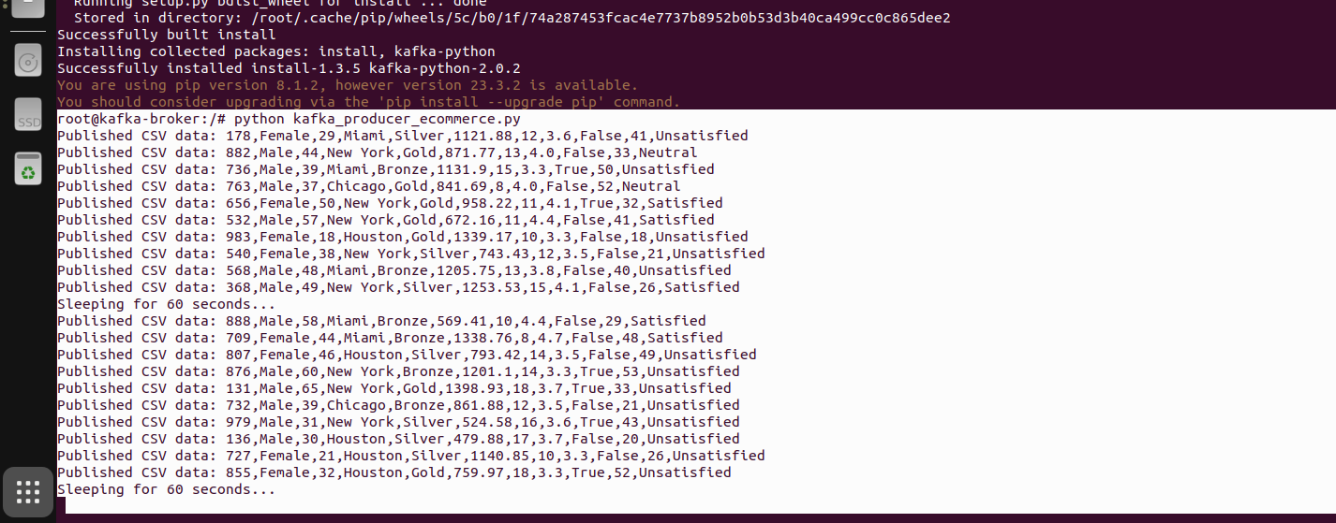
Producer workflow on Kafka Container
Producer to simulate real time E-commerce Data generator.

Slide 25
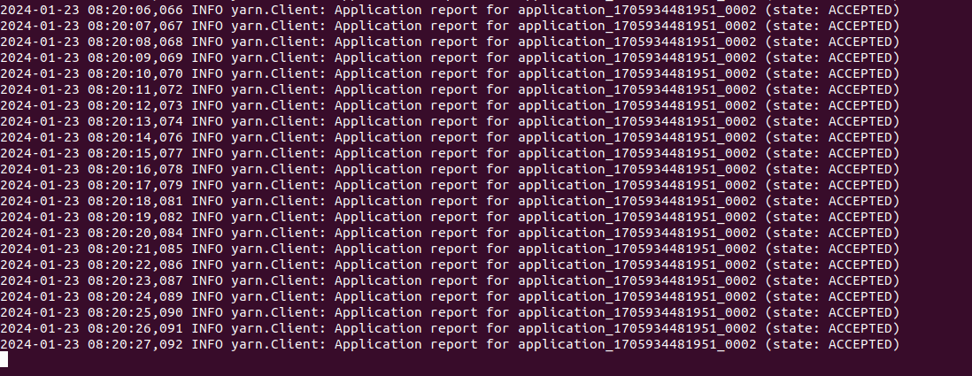
Consumer workflow + YARN

Slide 26
Thanks!

